Slide 1
MODULE : 1

Slide 2
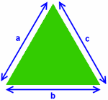
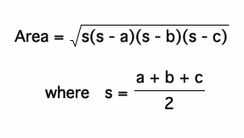
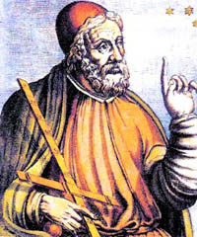
Heron’s formula

Slide 3
Heron’s Formula
A
Area of a triangle =
s(s – a) (s – b) (s – c )
Consider a triangle ABC
where,
c
b
Let a, b and c be the length of the three sides of this triangle
a, b and c are sides of ΔABC
a + b + c
and s(semi perimeter) =
2
B
C
a
To find area of such triangle, we have Heron’s formula
Perimeter of a triangle
a + b + c
What is semi perimeter of a triangle ?
2

Slide 4
Q.
A traffic signal board, indicating ‘SCHOOL AHEAD’, is an
equilateral
A traffic signal board, indicating ‘SCHOOL AHEAD’, is an
equilateral
triangle with side ‘a’
Find the area of the signal
triangle with side ‘a’. Find the area of the signal
using Heron’s formula.If its perimeter is 180cm, what will be
the area of the signal board ?
using Heron’s formula
Soln.
In ΔABC all sides are equal
If a, b, c be the lengths of sides BC, CA and AB of ΔABC
A
,
∴ AB = BC = AC = a
then
Area of ΔABC =
Area of ΔABC =
1
1
What is the formula for s ?
s = ( a + b + c )
s = ( a + b + c )
What is the Heron’s formula ?
s
(s – a)
(s – b)
(s – c )
s
(s – a)
(s – b)
(s – c )
a
a
2
2
Let us name it as ABC
SCHOOL
AHEAD
So,
what can we say about
a,b & c ?
In this formulae,
a,b & c
are sides of the triangle
Where,
But here,
ΔABC is an equilateral triangle
a = b = c
B
C
Since ΔABC is given as equilateral of side
a
‘a’
Hence, a = b = c
Area of ΔABC =
1
1
3a
s
3a
a
∴
s =
(a
+
a
+
a)
=
(3a)
=
(s – b)
(s – a)
(s – b)
(s – c )
=
−
a
=
2
2
2
2
2
3a
3a
−
2a
a
1
s
3a
a
Now,
(s – a)
=
−
a
=
=
(s – c )
=
=
−
(a
+
b
+
c)
2
2
2
2
a
=
2
2

Slide 5
MODULE : 2

Slide 6
3a
a
a
a
Area of ΔABC =
∴
Area of ΔABC
=
×
×
×
2
2
2
2
s
(s – a)
(s – b)
(s – c )
a
a
a
a
A
=
3
×
×
×
×
2
2
2
2
a
a
=
3
×
×
a
a
2
2
SCHOOL
AHEAD
3
a²
=
B
C
4
a
3
a²
3a
∴
Area of signal board =
s =
and
4
2
a
(s – a) =
(s – b) =
(s – c ) =
2

Slide 7
To find the area, when its perimeter
180cm
=
∴
a
+
a
+
a
=
180
3
a ²
Area of signal board =
4
∴
3a
=
180
60
180
A
∴
a
=
= 60
3
3
a
a
∴
Required area
=
×
(60)²
SCHOOL
AHEAD
4
3
15
B
C
=
×
60
×
60
a
4
=
3
×
15
×
60
=
900
3
=
900 × 1.73
=
1557
cm²
∴
Required area =
1557
cm²

Slide 8
MODULE : 3

Slide 9
Q.
The triangular side walls of a flyover have been used for
The triangular side walls of a flyover have been used for
advertisements.The sides of the walls are 122m, 22m and 120m
advertisements
The sides of the walls are 122m, 22m and 120m
(see figure).The advertisements yield an earning of Rs 5000 per m²
per year. A company hired one of its walls for 3 months.
How much rent did it pay ?
For the advertisements
the area of the triangular part is used
So, let us first find area
of the triangular wall
What is the area
of the triangle?
Soln.
What is the
formula for s ?
First we find the area of triangular side measuring 122m, 22m, and 120m.
s
1
s
(s – a)
(s – a)
(s – b)
(s – b)
(s – c)
s
=
(a
(s – c)
+
b
+
c)
Let
a
=
122m,
b
=
22m,
and
c
=
120m,
2
1
∴
s
=
(a
+
b
+
c )
2
1
=
(122
+
22
+
122m
120)
22m
2
1
132
120m
=
264
×
2
s
=
132m
Area of triangular wall =

Slide 10
Q.
The triangular side walls of a flyover have been used for
advertisements.The sides of the walls are 122m, 22m and 120m
(see figure).The advertisements yield an earning of Rs 5000 per m²
per year. A company hired one of its walls for 3 months.
How much rent did it pay ?
Now,
(s – a)
=
132
–
122
=
10m
(s – b)
=
132
–
22
=
110m
(s – c )
=
132
–
120
=
12m
122m
22m
Area of triangular wall
120m
∴
=
110
12
132
10
×
×
=
×
11
12
10
10
×
×
11
12
×
×
=
×
s
=
132m
12
12
a = 122, b = 22, c = 120
11
11
×
×
10
10
×
×
=
×
11
12
×
s
10
(s – a)
(s – b)
(s – c)
=
×
Area of tirangular wall =
=
Area of triangular wall
1320m²

Slide 11
MODULE : 4

Slide 12
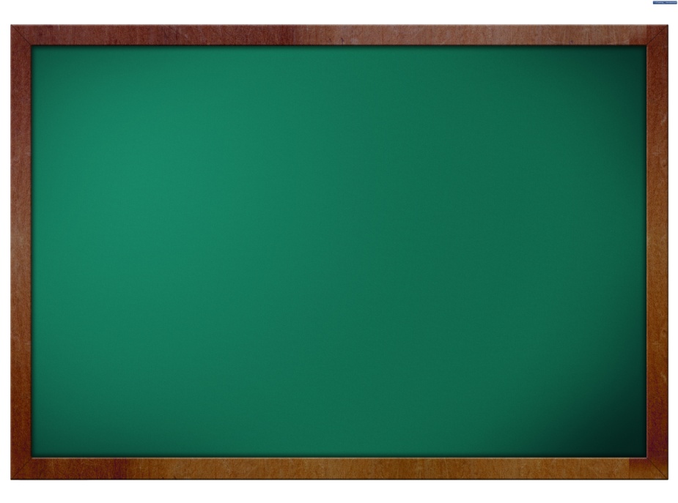
Q.
The triangular side walls of a flyover have been used for
advertisements.The sides of the walls are 122m, 22m and 120m
(see figure).The advertisements yield an earning of Rs 5000 per m²
The advertisements yield an earning of Rs 5000 per m²
per year.
per year. A company hired one of its walls for 3 months.
A company hired one of its walls for 3 months.
How much rent did it pay ?
1 year
→ Rs. 5000
∴
Rent charges
=
Rs 5000 per m² per year
12 months
What will be the
rent for 3 months?
Rent charged from a company for 3 months
3 months
→ Rent ?
3
=
Rs.
5000
×
per m²
12
12 × Rent =
5000 × 3
∴Total Rent charged from a company for 3 months
What is the rent for the triangular surface ?
= Area of the
triangular wall
× Rent charged per m² from
a company for 3 months
∴ Rent =
5000 × 3
12
110
But this rent is for
1m² of wall
×
×
3
=
1320
5000
=
Rs.
16,50,000
12
=
Area of triangular wall
1320m²
∴Total Rent charged from a company for 3 months = Rs. 16,50,000

Slide 13
MODULE : 5

Slide 14
Q.
One of its side walls has been painted
There is a slide in a park. One of its side walls has been painted
in blue colours with a message “KEEP THE PARK GREEN AND
in blue colours with a message “KEEP THE PARK GREEN AND
CLEAN” (see figure). If the sides of the wall are 15m, 11m and 6m,
CLEAN”
If the sides of the wall are 15m, 11m and 6m
find the
area painted in colour.
find the area painted in colour.
Soln.
Let
a
15m,
b
11m
and
c
6m,
6m
=
=
=
6m
11m
11m
KEEP THE PARK
GREEN AND CLEAN
15m
1
15m
=
(15
+
11
+
6)
2
1
16
=
32
Area of the side wall =
×
2
What is the formula for the area of this side wall?
=
16m
What is the formula for s ?
s
(s – a)
(s – b)
(s – c)
s
(s – a)
(s – b)
(s – c)
1
1
s = (a
+
s = (a
b
+
c)
+
b
+
c)
2
2

Slide 15
Now,
(s – a)
=
16
–
15
=
1m
s
(s – b)
=
16
–
11
=
5m
Area of the side wall =
(s – a)
(s – b)
(s – c)
(s – c)
=
16
–
6
=
10m
∴
6m
5
10
1
×
=
16
×
×
11m
KEEP THE PARK
GREEN AND CLEAN
4
×
4
5
5
2
=
×
×
×
15m
=
20
2
=
20 × 1.41
=
28.2 m²
s
=
16m
∴
Area painted in blue colour
=
Area of the side wall
a
=
15m
∴
=
28.2
m²
Area painted in blue colour
b
11m
=
c
=
6m

Slide 16
MODULE : 6

Slide 17
Q.
Find the area of a triangle
Find the area of a triangle two sides of which are 18cm and
two sides of which are 18cm and
10cm
the perimeter is 42cm
10cm and the perimeter is 42cm.
Soln.
Let a, b and c be the sides of a triangle such that
a
=
18cm,
b
=
10cm
and
perimeter = 42cm
What is the formula for s ?
In order to find area of the triangle, we should know the value of ‘s’
1
∴
a + b + c
=
42cm
s = (a
+
b
+
c)
2
∴
18
+
10
+
c
=
42
∴
c
42
–
10
–
=
18
∴
c
=
14 cm
What is the formula for the area of the triangle?
s
1
Area of the triangle =
s
(s – a)
(s – b)
(s – c)
(s – a)
(s – b)
(s – c)
(a
+
Now,
s
=
b
+
c)
2
1
21
=
42
×
2
=
21cm

Slide 18
Now,
(s – a)
=
21
–
18
=
3m
3
.3
s
(s – b)
=
21
–
10
=
11m
Area of the triangle =
(s – a)
(s – b)
(s – c)
3
11
.00
(s – c)
=
21
–
14
=
7m
+ 3
-
9
6
2
00
3
∴
Which number should be written besides 6 such that,
Let us find the square root correct upto one decimal only.
-
1 89
So, we have to take only one pair of zeroes after the no.
Which is the number whose square is less than or equal to 11?
s
21m
=
11
7
21
3
×
×
×
when we multiply the new number formed with the same digit , we should get a number equal to or less than 200 ?
3
3
11
=
a
=
18m
3
=
×
7
×
3
×
11
×
7
b
=
10m
∴
63 × 3 = 189
and 189 < 200
3 × 3 = 9
c
=
14m
∴
7
11
3
×
3
7
=
×
×
×
=
3
×
7
11
=
21
× 3.3
=
69.3
m²
∴
Area of the triangle
=
69.3
m²

Slide 19
MODULE : 7

Slide 20
Q.
Sides of a triangle are in the ratio of 12 : 17 : 25 and its
Sides of a triangle are in the ratio of 12 : 17 : 25
Find its area
perimeter is 540cm. Find its area.
perimeter
is 540cm
Soln.
Let a, b and c be the sides of a triangle
Area of
the triangle
√
s(s-a)(s-b)(s-c)
=
such that
a : b : c
=
12 : 17 : 25
Let the common multiple be k
∴
a
=
12k,
b
=
17k,
and
c
=
25k,
Also,
perimeter
=
540 cm
∴
a
+
b
+
c
=
540
What is the formula of area of a triangle ?
∴
12k
+
√
s(s-a)(s-b)(s-c)
17k
+
25k
=
540
∴
54k
=
540
10
∴
k
=
540
54
∴
k
=
10
∴
a
=
12
×
10
=
120 cm,
b
=
17
×
10
=
170 cm
and
c
=
25
×
10
=
250 cm

Slide 21
Now,
s
=
1
×
(a + b + c)
2
1
270
a = 120,b = 170, c = 250
∴
s
=
×
540
2
Area of
triangle
√
s(s-a)(s-b)(s-c)
∴
In order to find area of the triangle, we should know the value of ‘s’
=
s
=
270cm
What is the formula for s ?
1
(s – a)
270
–
120
150cm
s = (a
+
=
b
+
c)
=
2
a + b + c = 540
(s – b)
=
270
–
170
=
100cm
(s – c)
=
270
–
250
=
20cm
s
∴
Area of triangle
=
(s – a)
(s – b)
(s – c)
20
=
27
×
10
×
15
×
10
×
100
×
2
×
270
150
100
×
10
=
×
×
27
×
100
×
15
×
100
×
2
×
=
10
=
100
27
×
15
×
2
×
10
=
100
3
×
3
×
3
×
3
×
5
×
5
×
2
×
2
=
100
×
3
×
3
×
5
×
2
Area of the triangle =
9000 cm²

Slide 22
Thank You

